Slide 1
Points
VarArgs
Enum
Enhanced for loop
Instanceof
To String
Equal Method
Finalize method
Marker interface
Cloning
Autoboxing,
Autounboxing
String builder
String buffer

Slide 2
varargs
What is varargs in Java?
Let’s suppose you are creating a Java method. However, you are not sure how many arguments your method is going to accept. To address this problem, Java 1.5 introduced varargs.
Varargs is a short name for variable arguments. In Java, an argument of a method can accept arbitrary number of values. This argument that can accept variable number of values is called varargs.

Slide 3
The syntax for implementing varargs is as follows:
accessModifier methodName(datatype… arg) {
// method body
}
In order to define vararg, ... (three dots) is used in the formal parameter of a method.
A method that takes variable number of arguments is called a variable-arity method, or simply a varargs method.

Slide 4
Java enums
In this tutorial, we will learn about enums in Java. We will learn to create and use enums and enum classes with the help of examples.
In Java, an enum (short for enumeration) is a type that has a fixed set of constant values. We use the enum keyword to declare enums. For example,
enum Size {
SMALL, MEDIUM, LARGE, EXTRALARGE
}

Slide 5
Here, we have created an enum named Size. It contains fixed values SMALL, MEDIUM, LARGE, and EXTRALARGE.
These values inside the braces are called enum constants (values).
Note: The enum constants are usually represented in uppercase.

Slide 6
Example : Java Enum with the switch statement
enum Size {
SMALL, MEDIUM, LARGE, EXTRALARGE
}
class Test {
Size pizzaSize;
public Test(Size pizzaSize) {
this.pizzaSize = pizzaSize;
}
public void orderPizza() {
switch(pizzaSize) {
case SMALL:
System.out.println("I ordered a small size pizza.");
break;
case MEDIUM:
System.out.println("I ordered a medium size pizza.");
break;
default:
System.out.println("I don't know which one to order.");
break;
}
}
}
class Main {
public static void main(String[] args) {
Test t1 = new Test(Size.MEDIUM);
t1.orderPizza();
}
}

Slide 7
Enum Class in Java
in Java, enum types are considered to be a special type of class.
An enum class can include methods and fields just like regular classes.
enum Size {
constant1, constant2, …, constantN;
// methods and fields
}
When we create an enum class, the compiler will create instances (objects) of each enum constants. Also, all enum constant is always public static final by default.

Slide 8
xample 3: Java Enum Class
enum Size{
SMALL, MEDIUM, LARGE, EXTRALARGE;
public String getSize() {
// this will refer to the object SMALL
switch(this) {
case SMALL:
return "small";
case MEDIUM:
return "medium";
case LARGE:
return "large";
case EXTRALARGE:
return "extra large";
default:
return null;
}
}
public static void main(String[] args) {
// call getSize()
// using the object SMALL
System.out.println("The size of the pizza is " + Size.SMALL.getSize());
}
}

Slide 9
In the above example, we have created an enum class Size. It has four constants SMALL, MEDIUM, LARGE and EXTRALARGE.

Slide 10
Methods of Java Enum Class
There are some predefined methods in enum classes that are readily available for use.
1. Java Enum ordinal()
The ordinal() method returns the position of an enum constant. For example,
ordinal(SMALL)
// returns 0

Slide 11
2. Enum compareTo()
The compareTo() method compares the enum constants based on their ordinal value. For example,
Size.SMALL.compareTo(Size.MEDIUM)
// returns ordinal(SMALL) - ordinal(MEDIUM)

Slide 12
3. Enum toString()
The toString() method returns the string representation of the enum constants. For example,
SMALL.toString()
// returns "SMALL"

Slide 13
3. Enum toString()
The toString() method returns the string representation of the enum constants. For example,
SMALL.toString()
// returns "SMALL"

Slide 14
4. Enum name()
The name() method returns the defined name of an enum constant in string form. The returned value from the name() method is final. For example,
name(SMALL)
// returns "SMALL"
5. Java Enum valueOf()
The valueOf() method takes a string and returns an enum constant having the same string name. For example,
Size.valueOf("SMALL")
// returns constant SMALL.

Slide 15
Java toString() Method
If you want to represent any object as a string, toString() method comes into existence.
The toString() method returns the String representation of the object.
If you print any object, Java compiler internally invokes the toString() method on the object. So overriding the toString() method, returns the desired output, it can be the state of an object etc. depending on your implementation.

Slide 16
instanceof
class A
p.s.v.m(String args[])
{
A a1=new A();
s.o.pln(a1 instanceof of A)

Slide 17
What is toString()
A toString() is an in-built method in Java that returns the value given to it in string format. Hence, any object that this method is applied on, will then be returned as a string object.

Slide 18
How to use the toString() method
class HelloWorld {
public static void main( String args[] ) {
// The method is called on datatype Double
// It is passed the double value as an argument
System.out.println(Double.toString(11.0));
// Implementing this on other datatypes
//Integer
System.out.println(Integer.toString(12));
// Long
System.out.println(Long.toString(123213123));
// Booleam
System.out.println(Boolean.toString(false));
}
}

Slide 19
class Pet{
String name;
Integer age;
Pet(String n, Integer a){
this.name=n;
this.age=a;
}
//Over-riding the toString() function as a class function
public String toString(){
return "The name of the pet is " + this.name + ". The age of the pet is " + this.age;
}
}
class HelloWorld {
public static void main( String args[] ) {
Pet p = new Pet("Jane",10);
//Calling the class version of toString()
System.out.println(p.toString());
//Calling the original toString()
System.out.println(Integer.toString(12));
}
}

Slide 20
public class Employee{
int id;
String name;
String city;
Employee(int id, String name, String city){
this.id=id;
this.name=name;
this.city=city;
}
public String toString(){//overriding the toString() method
return id+" "+name+" "+city;
}
public static void main(String args[]){
Employee e1=new Employee(01,"Ari","NewYork");
Employee e2=new Employee(02,"Jon","Chicago");
System.out.println(e1);
System.out.println(e2);
}
}

Slide 21
What is constructor chaining
n Java, constructor chaining is a sequence of invoking constructors upon initializing an object. It is used when we want to invoke a number of constructors, one after another by using only an instance. In this section, we will discuss constructor chaining in Java in detail with proper examples. Let's have a quick look at what is a constructor in Java.
There are two types of constructor in Java:
Default Constructor (also known as a no-argument constructor)
Parameterized Constructor

Slide 22
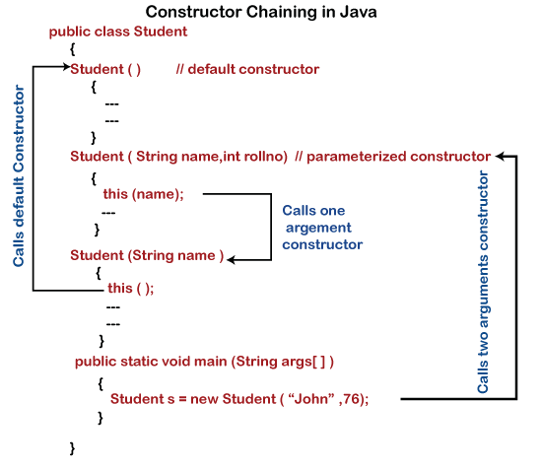

Slide 23
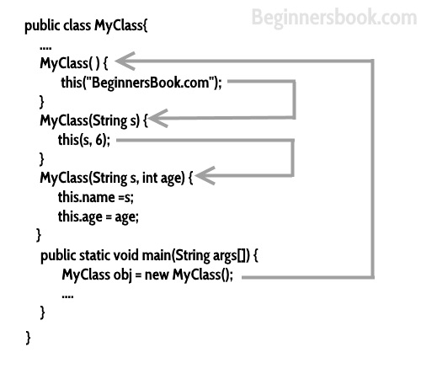

Slide 24
class Employee
{
public String empName;
public int empSalary;
public String address;
//default constructor of the class
public Employee()
{
//this will call the constructor with String param
this("Chaitanya");
}
public Employee(String name)
{
//call the constructor with (String, int) param
this(name, 120035);
}
public Employee(String name, int sal)
{
//call the constructor with (String, int, String) param
this(name, sal, "Gurgaon");
}
public Employee(String name, int sal, String addr)
{
this.empName=name;
this.empSalary=sal;
this.address=addr;
}
void disp() {
System.out.println("Employee Name: "+empName);
System.out.println("Employee Salary: "+empSalary);
System.out.println("Employee Address: "+address);
}
public static void main(String[] args)
{
Employee obj = new Employee();
obj.disp();
}
}

Slide 25
class StringBuilderExample{
p.s.v.m(String args[])
{
StringBuilder sb=new StringBuilder(“hello”);
sb.append(“Java”);
sb.repace(1,3,”java”)

Slide 26
Class Autobox{
p.s.v.m(String args[])
{
Interger a,b;
A=100;
b

